Slide 1
ECOM-EXPRESS LIMITED
By Faith Ejele

Slide 2
Business Overview/Problem
E-Com Express, founded in 2010 and based in the United States, is a fast-growing e-commerce retailer specializing in consumer electronics, home appliances, and lifestyle products. Initially starting as a small online store, the company quickly gained traction with its emphasis on providing high-quality products at competitive prices. The company primarily offers a wide range of consumer electronics, home appliances, and lifestyle products such as fitness gear, kitchen gadgets, and gaming equipment. E-Com Express differentiates itself through exclusive deals, flash sales, and targeted promotional offers, all of which are integral to its marketing strategy. E-Com Express operates in a competitive environment with a focus on product variety, fast delivery, and customer service, their current baseline conversion rate is around 2.5%.

Slide 3
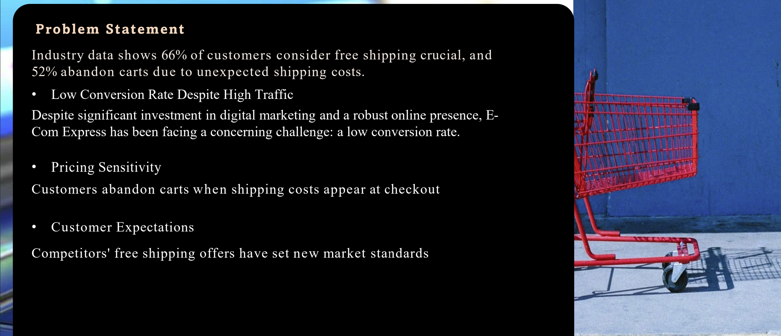
Problem Statement

Slide 4
Aim
Test the effectiveness of discounts vs. free shipping on conversion rates
Measure customer behaviors including cart abandonment and order value
Optimize revenue and conversion cost-effectively
Refine marketing strategies to maximize ROI
Improve customer loyalty through better understanding of preferences

Slide 5
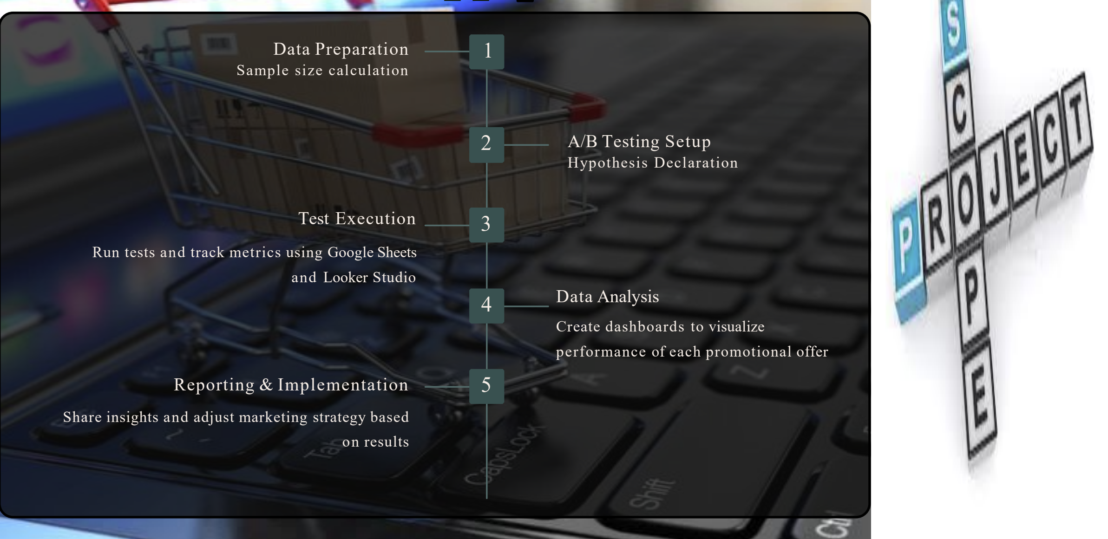
Ecom Express Ltd- Scope

Slide 6
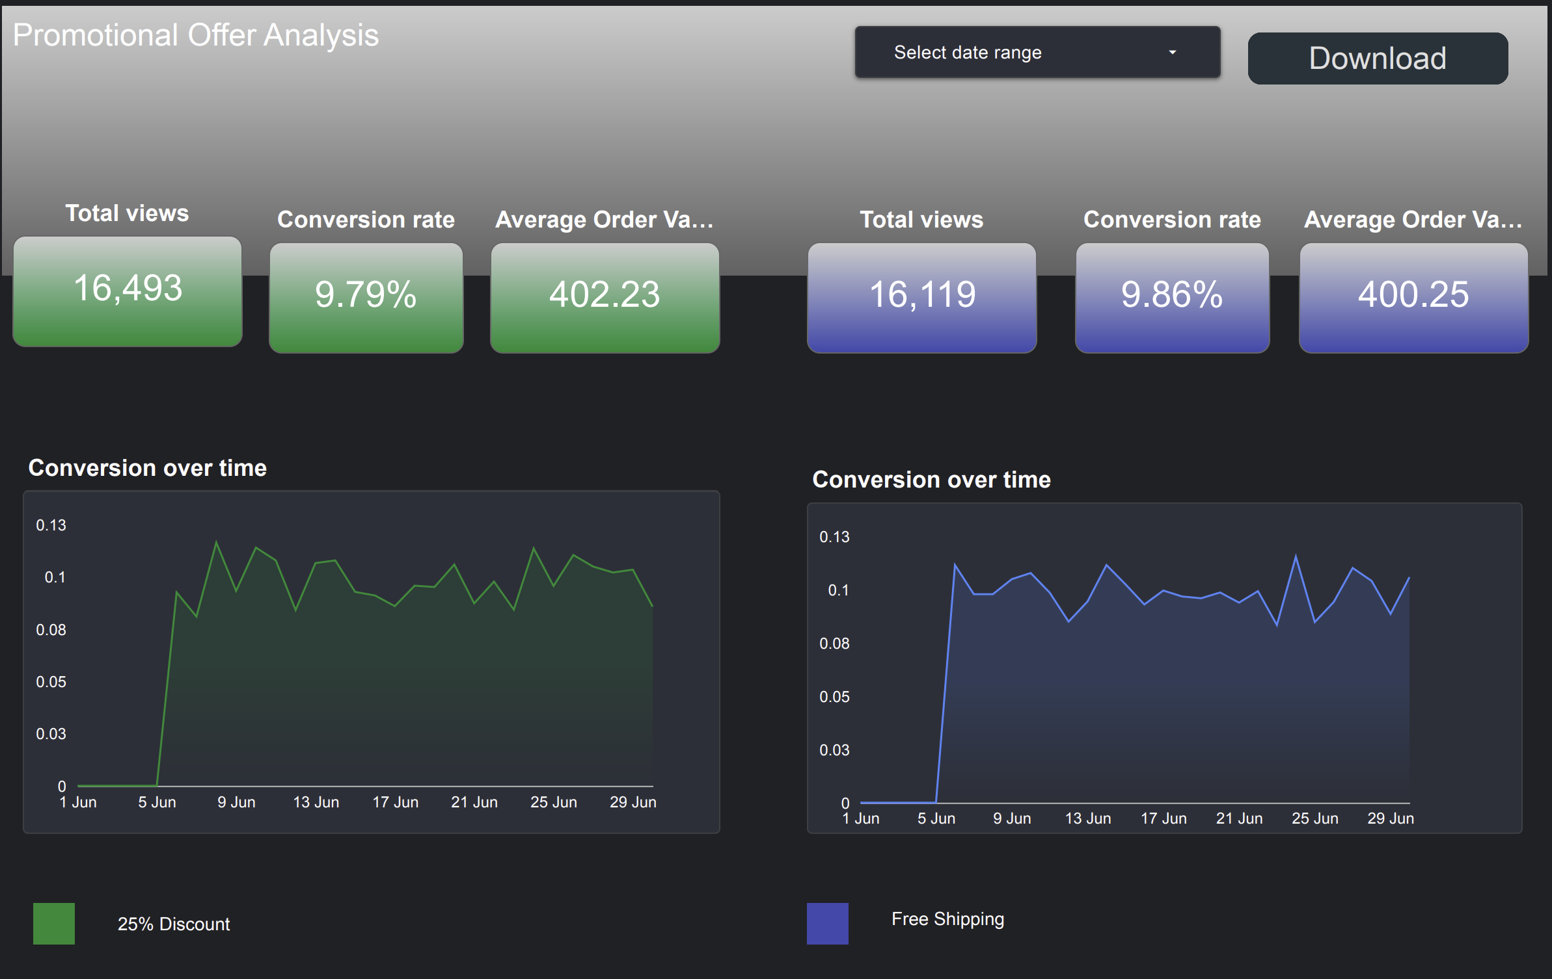
Looker Studio- 25% Discount VS Free Shipping

Slide 7
25% Discount Vs Free Shipping Offer
"During the promotional period, the 25% discount offer attracted a total of 16,493 views, slightly higher than the 16,119 views recorded for the free shipping offer. However, the free shipping campaign achieved a higher conversion rate of 9.86%, outperforming the 25% discount offer. In terms of average order value (AOV), customers who engaged with the 25% discount spent slightly more at $402.23, compared to $400.25 for those who responded to the free shipping offer. While the 25% discount drew more attention, the free shipping promotion proved more effective in converting views into sales, suggesting a better performance in terms of customer conversion efficiency."

Slide 8
Performance DashBoard- Summary
"Sales trends in Q2 (June 1–June 29) showed a significant increase, with total sales rising from $6.15 million to $332.47 million, despite price fluctuations throughout the period. In terms of order status, completed sales accounted for only 14.83%, while 85.1% of items were abandoned in cart. Comparing promotional offers, the 25% discount generated $4.36 million in sales, slightly outperforming the free shipping offer, which recorded $4.30 million."

Slide 9
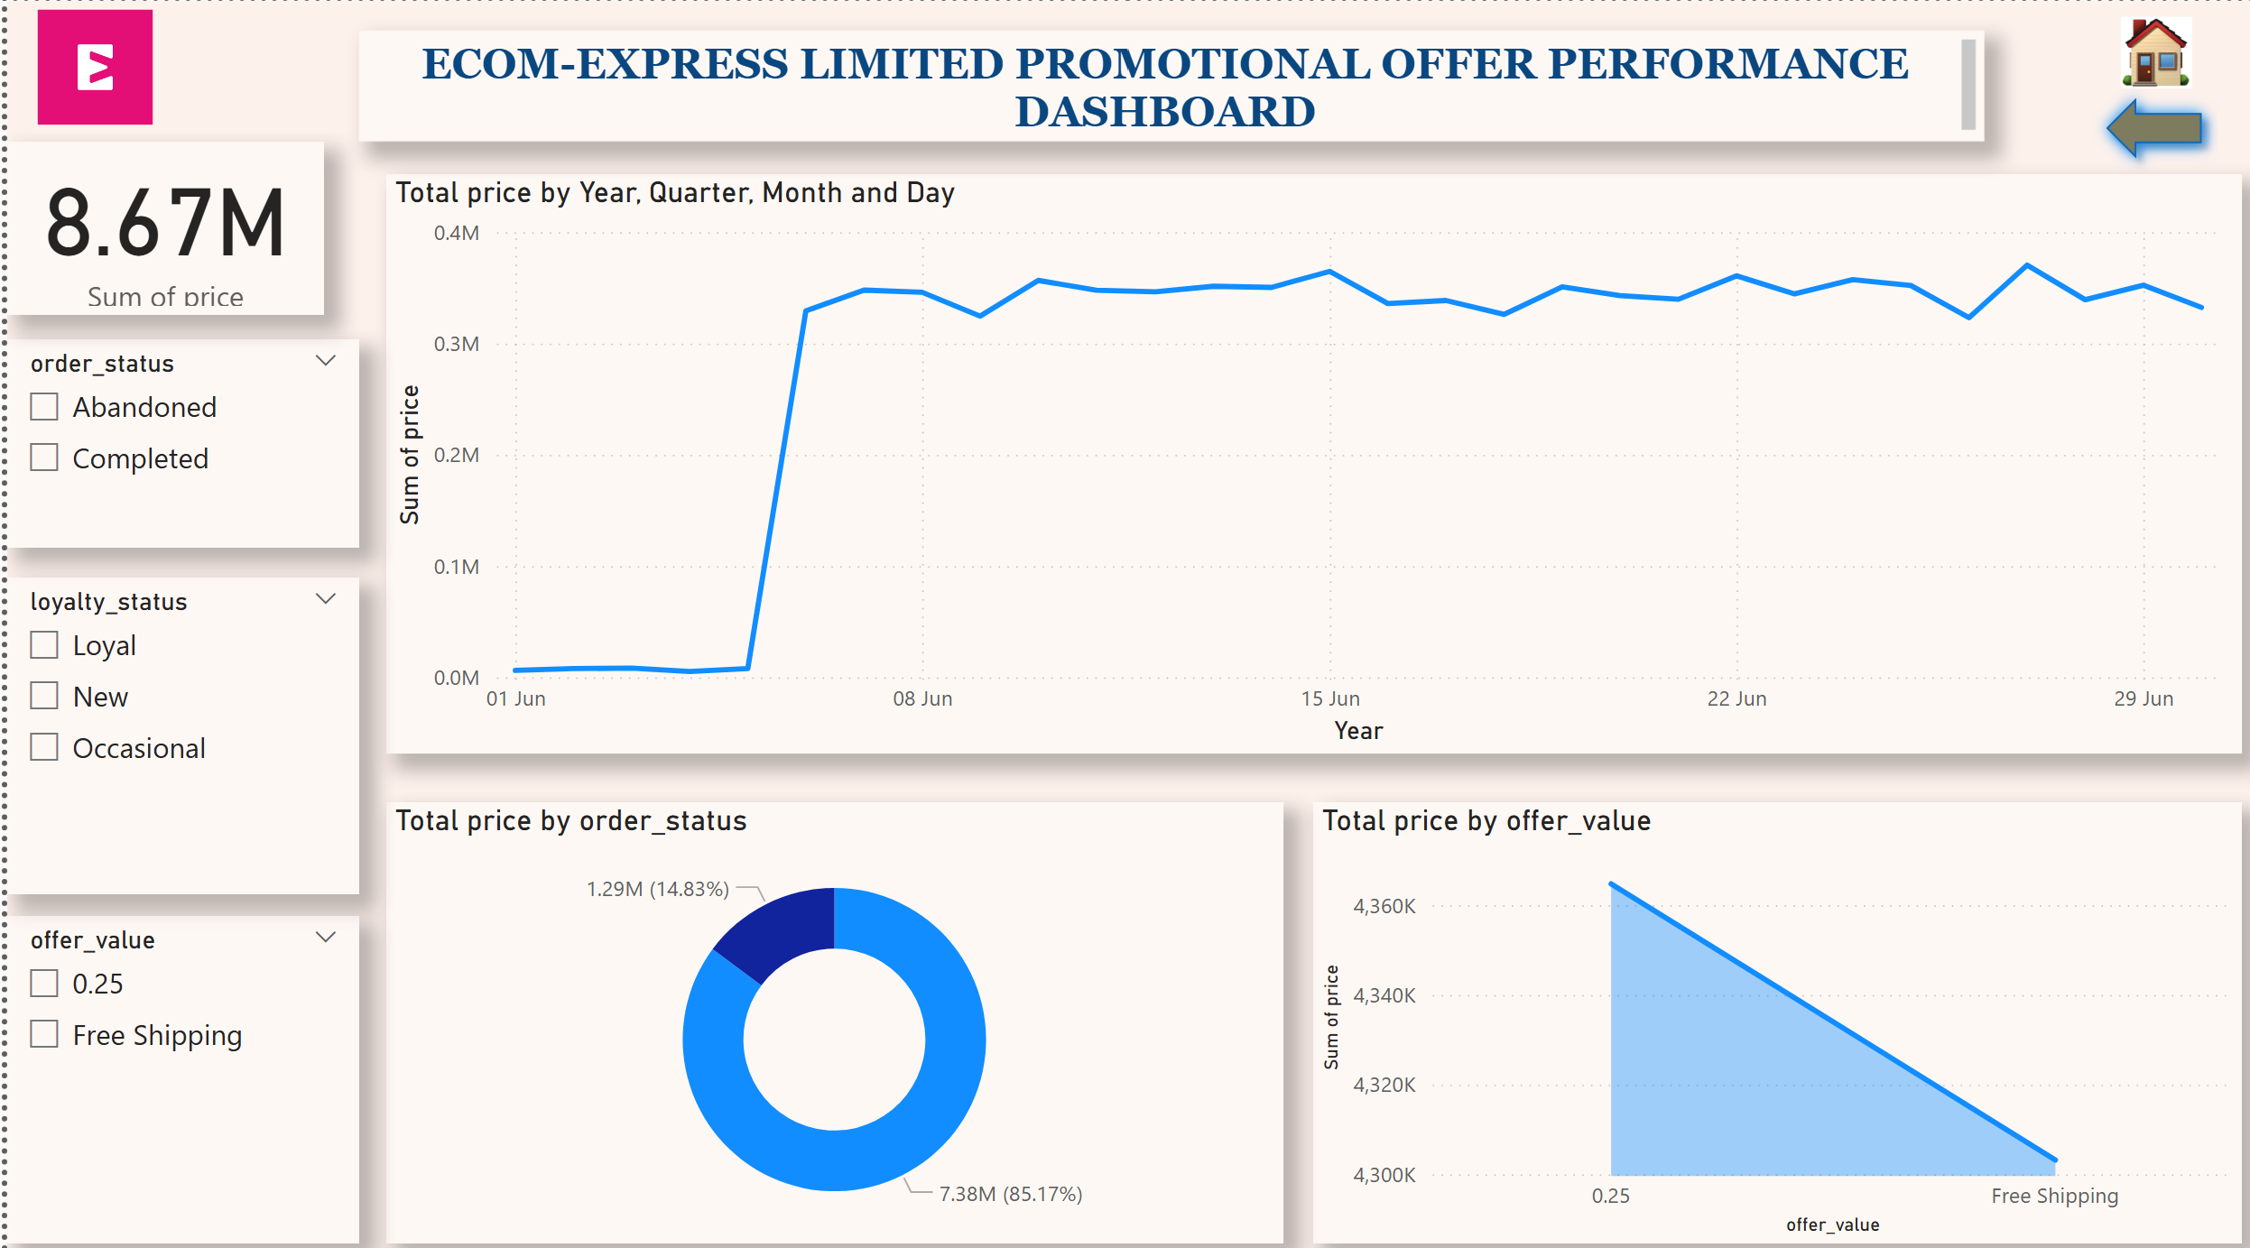

Slide 10
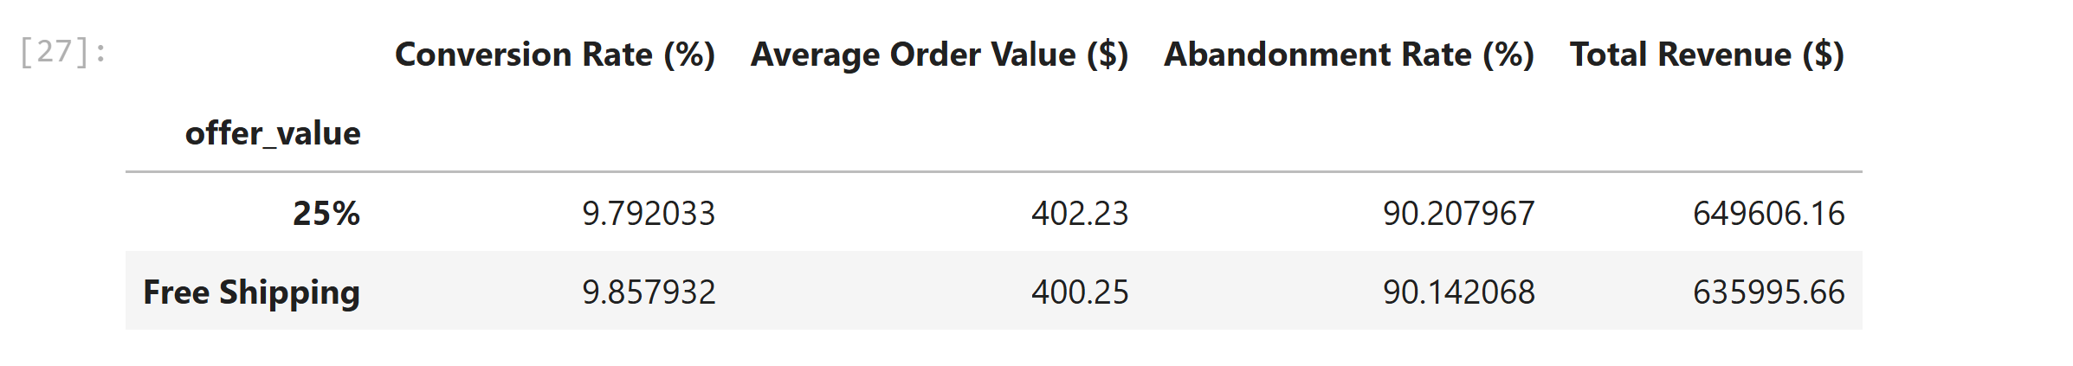
Offer_Value Metrics

Slide 11
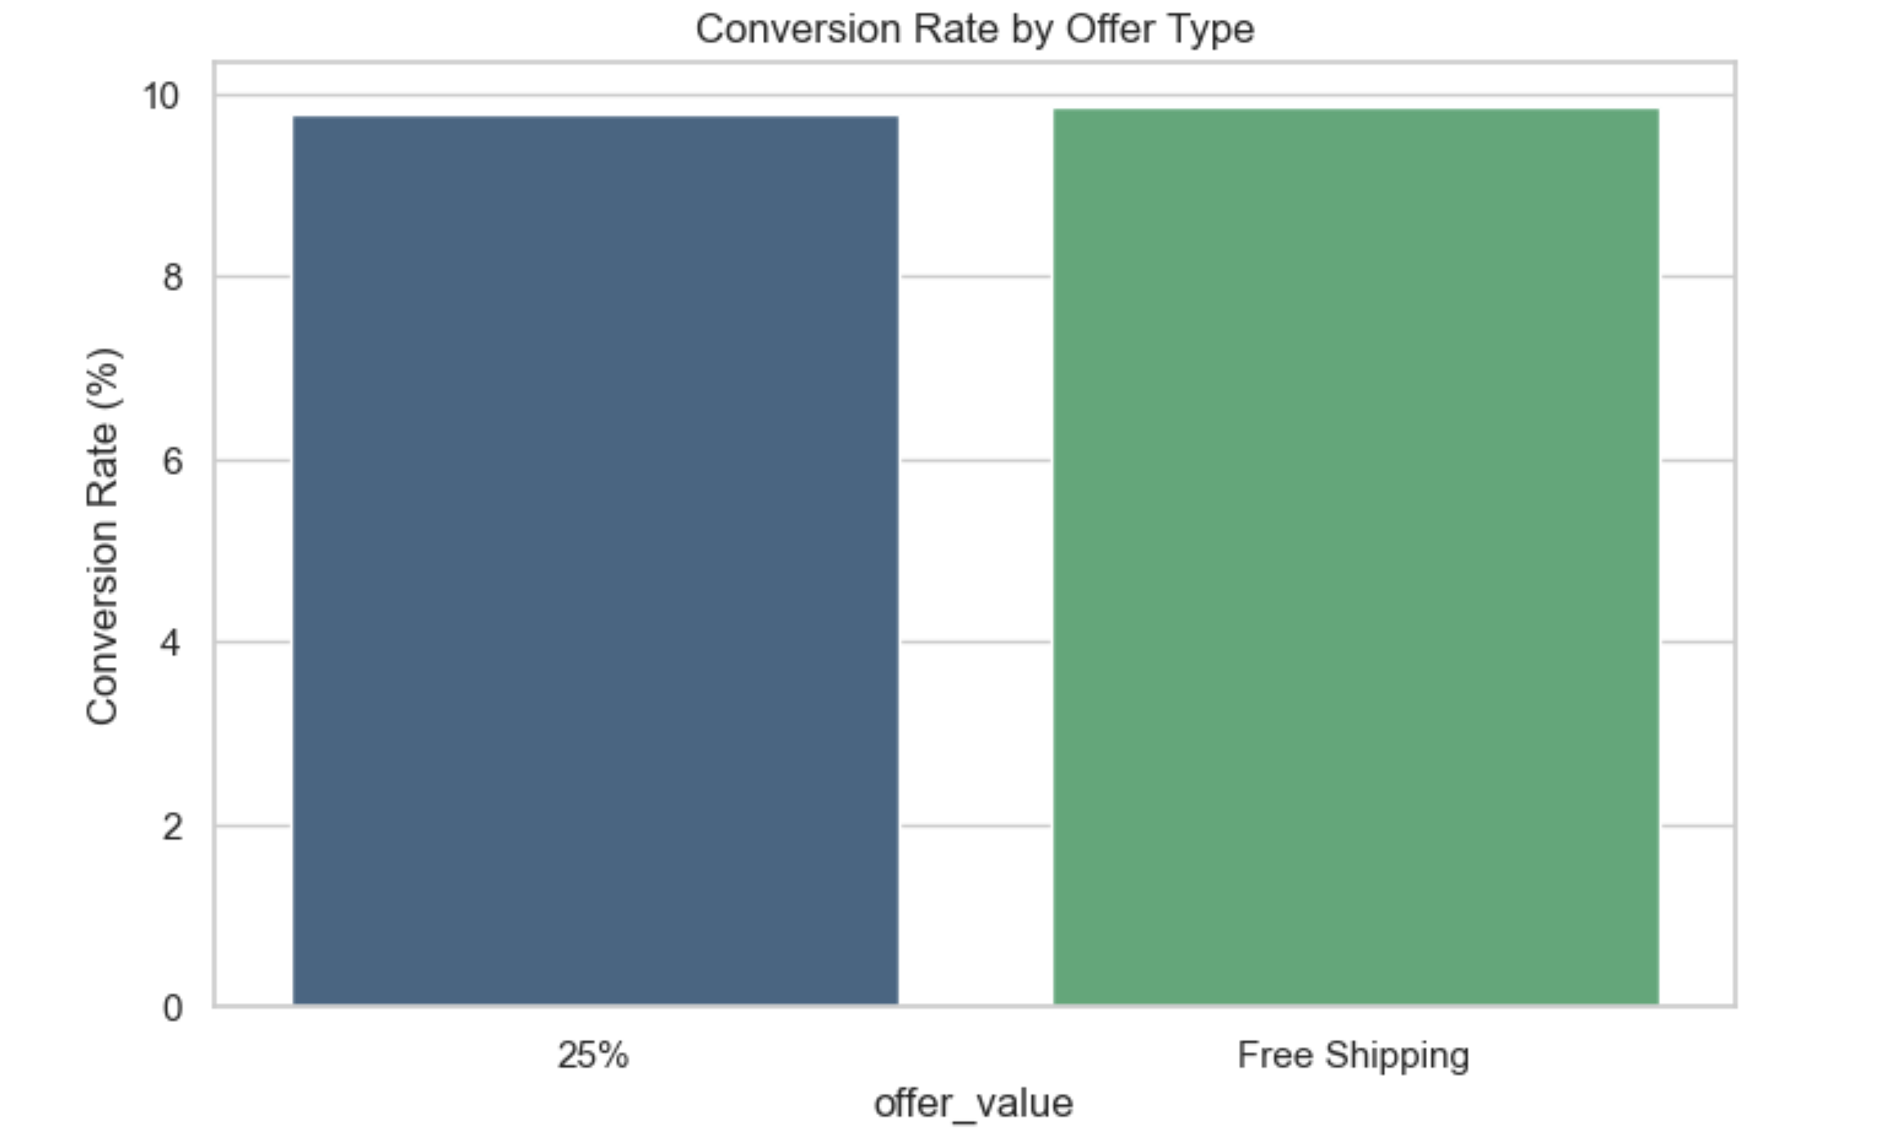
Conversion Rate- 25% Vs Free Shipping

Slide 12
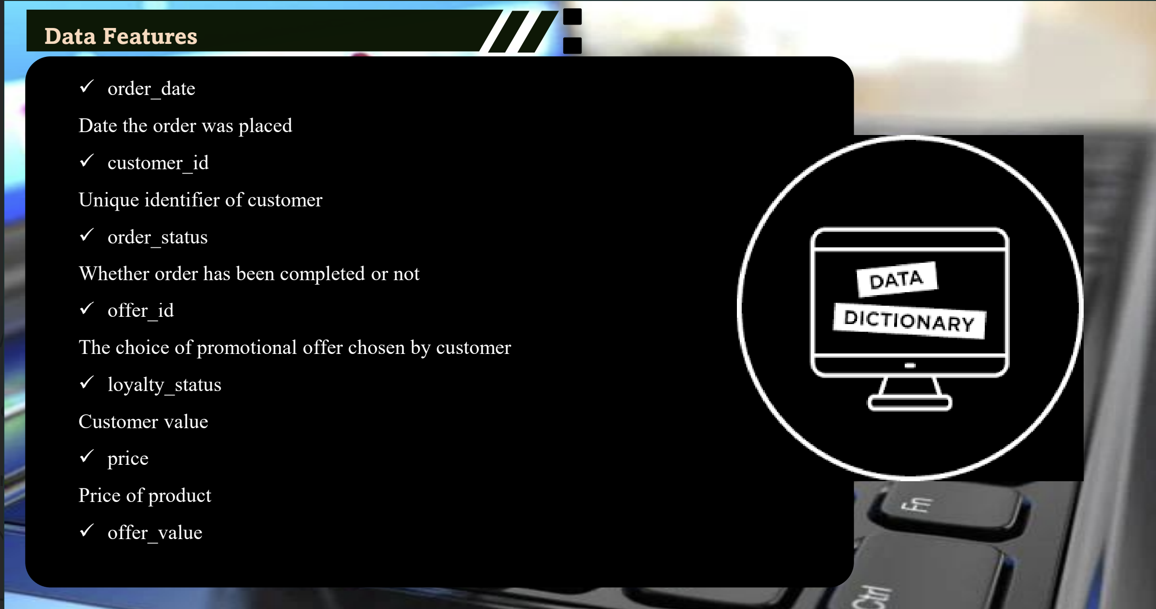
Data Dictionary

Slide 13
Conclusion
Offer Performance AnalysisOur analysis compared the 25% Discount offer with the Free Shipping offer to understand which drives better customer engagement and sales.Customer Views: Both offers attracted a similar number of views, with the 25% Discount slightly ahead.Conversion Rates: Free Shipping converted a higher percentage of visitors into paying customers compared to the 25% Discount.Average Order Value: Customers who used the 25% Discount spent slightly more per order than those who used Free Shipping.Abandonment Rate: A large share of visitors did not complete their purchases for both offers, but abandonment was slightly lower for Free Shipping

Slide 14
Conclusion Contd…
Free Shipping is better at turning visitors into buyers, while the 25% Discount generates slightly higher spend per customer. Depending on business goals — higher sales volume vs. higher order value — we can adjust our promotional strategy, or test a combined offer for potentially better results.

